Slide 1
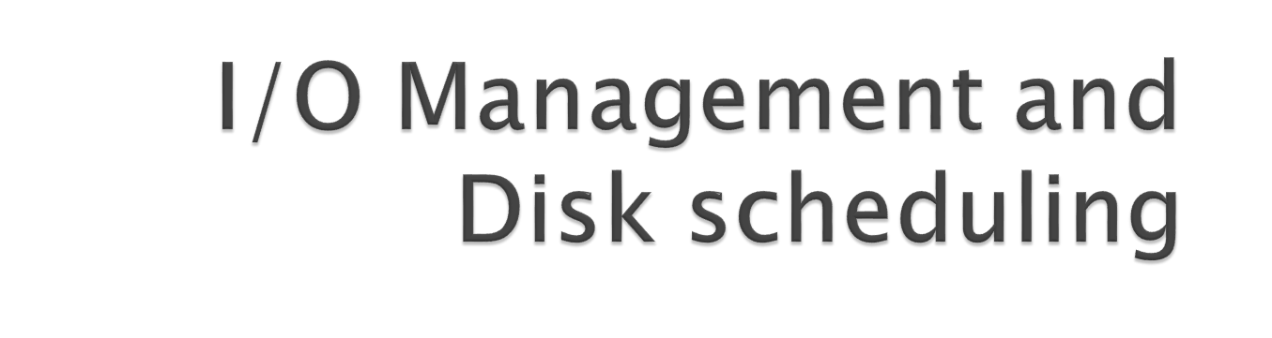
Dr. Tasneem Mirza

Slide 2

I/O management – Messiest part of the design of an OS due to a variety of devices attached to a system and speed mismatch.
With time processor speeds are increasing and so is the internal memory access speeds.
But I/O remains a significant performance challenge especially in the case of disk storage.

Slide 3

Disk is a secondary storage device that is used to store data.
Disks provide a means to store a large amount of information for modern computer. Examples : Hard Disk
A Disk is usually divided into TRACKS, CYLINDERS AND SECTORS .
Hard disks drives are organized as a concentric stack of disks or ‘platters’.
Each platter has 2 surfaces and two read/write heads for each surface.

Slide 4
Multi-platter Disk
read/write head
read/write arm
Disk
platter

Slide 5
Tracks- circular areas of the disk
Sectors- Divide tracks into sections
Cylinders- Logical groupings of the same track on each disk surface in a disk unit.
OR
All the tracks with the same radius are known as a CYLINDER.

Slide 6

Multi-platter Disk
track
cylinder
sector

Slide 7


A. Frank - P. Weisberg

Slide 8
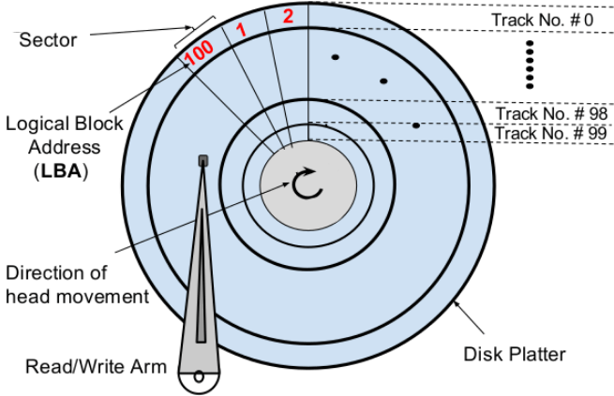

Slide 9
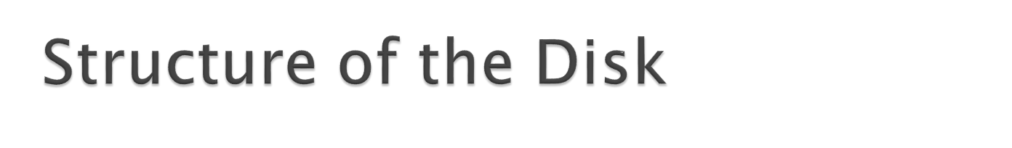
Disk drives are addressed as large 1-dimensional arrays of logical blocks, where the logical block is the smallest unit of transfer.
The 1-dimensional array of logical blocks is mapped into the sectors of the disk sequentially.
  Sector 0 is the first sector of the first track on the outermost cylinder.
  Numbering physical sectors within a track starts with 1. Sector 1 Track 0 Sector 2 Track 0
  Mapping proceeds in order through that track, then the rest of the tracks in that cylinder, and then through the rest of the cylinders from outermost to innermost.

Slide 10
Disk performance parameters
Seek Time
Measures the amount of time required for the read/write heads to move between tracks over the surface of the platters
0.0 ms
0.8 ms
platter

Slide 11
Disk performance parameters
Rotational delay
After the read/write arm has picked the right track, the time it takes for the requested sector (on that track) to come under the read/write head
0.0 ms
0.2 ms
read/write arm
platter

Slide 12

To perform a read and write the head must be positioned at the desired track and at the beginning of the desired sector on that track.
Assuming a moving head system , the time it takes to position the head at the desired track is called as the seek time.
Next , once the track is selected, the disk controller waits until the appropriate sector rotates to line up with the head.
The time it takes for the beginning of the sector to reach the head is called the rotational delay.
Once the head is in position , the read /write is performed as the sector moves under the head. This is the data transfer portion of the operation i.e the transfer time.

Slide 13
Transfer Time
Transfer time = the time it takes to transfer a block of bits, typically a sector, under the read/write head.
Hence :
The total access time =
Seek time + Rotational delay + Transfer time

Slide 14

In a multiprogramming environment, there will be I/O requests(read/write) from multiple processes competing for the same disk.
Seek time is very crucial.
When there are multiple requests to access the disk, the requests are in the form of which track which sector.
Disk scheduler is that component of the operating system which decides in which order the requests from processes for disk access should be served.
There are several disk scheduling policies that the OS uses :

Slide 15
In a multiprogramming environment, the operating system maintains a queue of requests from various processes for the disk.
Assume a disk has 200 tracks.
The requested tracks, in the order received by the disk scheduler are -----→
Currently the head is on track no. 53
98
183
37
122
14
124
65
67

Slide 16
The disk scheduling policies :
FCFS
SSTF
SCAN
LOOK

Slide 17
First come first serve
Simplest form of scheduling
Services the requests in sequential order in the queue.
Fair to all processes but does not provide the fastest service time.

Slide 18
Disk Scheduling
FCFS/FIFO
Head at 53
98
98
183
183
37
37
122
122
14
14
124
124
65
65
67
Head at 53
67
0
14
37
53
65
67
98
122
124
183
199
45
45
85
+
85
146
+
146
85
+
85
108
+
108
110
+
110
59
+
59
2
+
2
=
640

Slide 19
There is a total head movement of 640 tracks.
Huge swing from 122 to 14 and then back to 124 with this policy.
If the requests for tracks 37 and 14 could be serviced together , and so also 122 and 124, then the total head movement could be decreased substantially and hence there would be improvement in performance.

Slide 20
2. Shortest seek time first :
Services the requests close to the current head position, before moving the head far away to service other requests.
Currently the head is on track no. 53
98
183
37
122
14
124
65
67

Slide 21
Disk Scheduling
Shortest Seek Time First - SSTF
Head at 53
98
98
183
183
37
37
122
122
14
14
124
124
65
65
67
Head at 53
67
0
14
37
53
65
67
98
122
124
183
199
12
12
2
+
2
30
+
30
23
+
23
84
+
84
24
+
24
2
+
2
59
+
59
=
236

Slide 22
3. SCAN scheduling
In the SCAN algorithm, the disk arm starts at one end of the disk and moves toward the other end, servicing requests as it reaches each track, until it gets to the other end of the disk.
At the other end, the direction of head movement is reversed, and servicing continues.
The head continuously scans back and forth across the disk.
The SCAN algorithm is sometimes called the elevator algorithm, since the disk arms behaves just like an elevator in a building, first servicing all the requests going up and then reversing to service requests the
other way.

Slide 23
If a request arrives in the queue just in front of the head, it will be serviced almost immediately.
If a request arriving just behind the head will have to wait until the arm moves to the end of the disk, reverses direction, and comes back.

Slide 24
Disk Scheduling
Scan
Head at 53
98
98
183
183
37
37
122
122
14
14
124
124
65
65
67
Head at 53
67
0
14
37
53
65
67
98
122
124
183
199
16
16
+
23
23
+
14
14
+
65
65
+
2
2
+
31
31
+
24
24
+
2
2
+
59
59
=
236

Slide 25
C-scan
Circular SCAN (C-SCAN) scheduling is a variant of SCAN designed to provide a more uniform wait time.
Like SCAN, CSCAN moves the head from one end of the disk to the other, servicing requests along the way. When the head reaches the other end, however, it immediately returns to the beginning of the disk, without servicing any requests on the return trip.
Treats the tracks as a circular list that wraps around from the final track to the first one

Slide 26
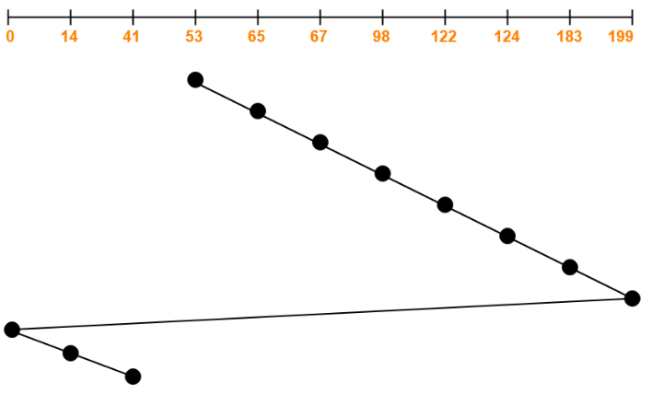
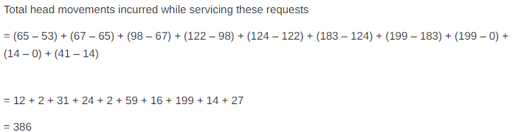
C-Scan eg.
Currently the head is on track no. 53
Consider a disk queue with requests for I/O to blocks on cylinders 98, 183, 41, 122, 14, 124, 65, 67. The C-SCAN scheduling algorithm is used. The head is initially at cylinder number 53 moving towards larger cylinder numbers on its servicing pass.

Slide 27
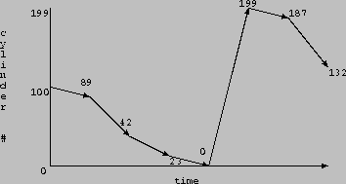
Work Queue: 23, 89, 132, 42, 187
there are 200 cylinders numbered from 0 - 199
the disk head stars at number 100
C-SCAN

Slide 28
4. LOOK
The arm goes only as far as the final request in each direction.
Then, it reverses direction immediately, without going all the way to the end of the disk.
Versions of SCAN and C-SCAN that follow this pattern are called LOOK and C-LOOK scheduling.

Slide 29
Look Algorithm is actually an improves version of SCAN Algorithm.
In this algorithm, the head starts from first request at one side of disk and moves towards the other end by serving all requests in between.
After reaching the last request of one end, the head reverse its direction and returns to first request, servicing all requests in between.
Unlike SCAN, in this the head instead of going till last track, it goes till last request and then direction is changed.

Slide 30
Disk Scheduling
Look
Head at 53
98
98
183
183
37
37
122
122
14
14
124
124
65
65
67
Head at 53
67
0
14
37
53
65
67
98
122
124
183
199
16
16
23
+
23
51
+
51
2
+
2
31
+
31
24
+
24
2
+
2
59
+
59
=
208

Slide 31
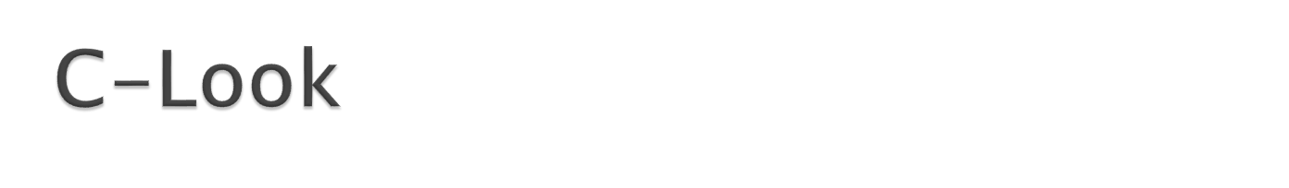
In this algorithm, the head starts from first request in one direction and moves towards the last request at other end, serving all request in between.
After reaching last request in one end, the head jumps in other direction and move towards the remaining requests and then satisfies them in same direction as before.
Unlike LOOK, it satisfies requests only in one direction.

Slide 32

Consider a disk with 200 tracks (0-199) and the disk queue having I/O requests in the following order as follows:
98, 183, 40, 122, 10, 124, 65.
The current head position of the Read/Write head is 53 and will move in Right direction .
Calculate the total number of track movements of Read/Write head using C-LOOK algorithm.

Slide 33

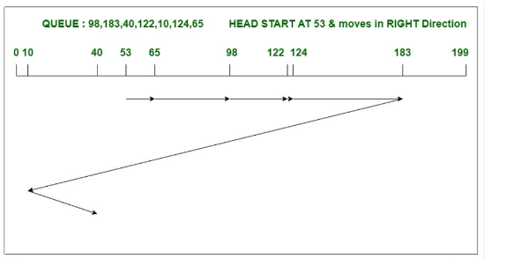
Total head movements,
= (65-53)+(98-65)+(122-98) +(124-122)+(183-124)+(183-10)+(40-10) = 333

Slide 34
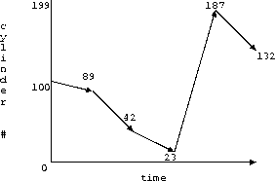
Work Queue: 23, 89, 132, 42, 187
there are 200 cylinders numbered from 0 - 199
the disk head stars at number 100
C LOOK

Slide 35

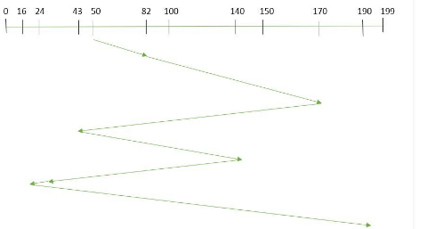
Suppose the order of request is- (82,170,43,140,24,16,190)
And current position of Read/Write head is at track: 50
Total head movement

Slide 36

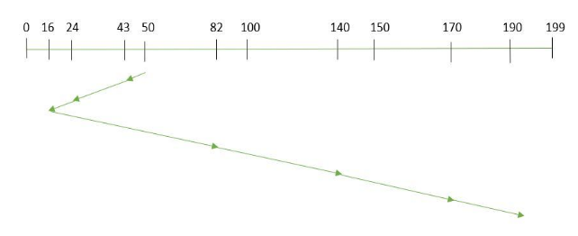

Suppose the order of request is- (82,170,43,140,24,16,190)
And current position of Read/Write head is at track: 50
Total head movement

Slide 37

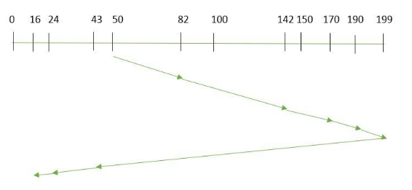
Suppose the order of request is- (82,170,43,140,24,16,190)
And current position of Read/Write head is at track: 50 and it is also given that the disk arm should move “towards the larger value”.
Total head movement =(199-50)+(199-16)
=332

Slide 38

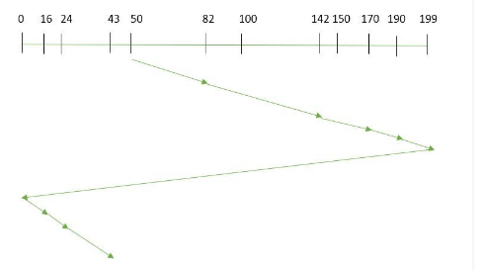

Suppose the order of request is- (82,170,43,140,24,16,190)
And current position of Read/Write head is at track: 50 and it is also given that the disk arm should move “towards the larger value”.
Total Head movement

Slide 39

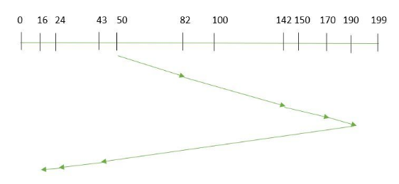

Suppose the order of request is- (82,170,43,140,24,16,190)
And current position of Read/Write head is at track: 50 and it is also given that the disk arm should move “towards the larger value”.
Total Head movement

Slide 40

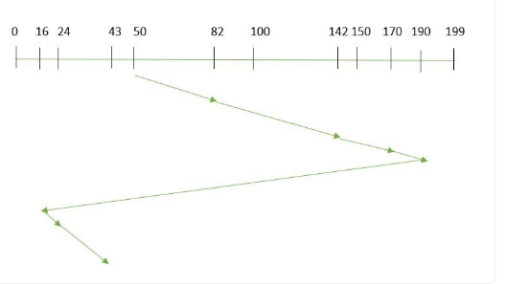
Suppose the order of request is- (82,170,43,140,24,16,190)
And current position of Read/Write head is at track: 50 and it is also given that the disk arm should move “towards the larger value”.
Total Head movement =(190-50)+(190-16)+(43-16)
=341

Slide 41

Input and output (I/O) devices allow us to communicate with the computer system.
I/O is the transfer of data between primary memory and various I/O peripherals.
Input devices such as keyboards, mouse, card readers, scanners, voice recognition systems, and touch screens enable us to enter data into the computer.
Output devices such as monitors, printers, plotters, and speakers allow us to get information from the computer.

Slide 42

How is IO handled by the computer system
Wide variety of peripherals
Delivering different amounts of data
At different speeds

Slide 43

Need I/O module to act as bridge between processor and the peripherals
Device Interface
Processor
External sensors
and controls
I/O Module
Bus
Device Interface
Device Interface

Slide 44

Data transfer between the computer system and I/O devices can be handled in three types of modes which are given below:
Programmed I/O
Interrupt Initiated I/O
Direct Memory Access

Slide 45

IO operation refers to a data transfer between an IO device and main memory.
The data transfer methods are distinguished by the extent to which the CPU is involved in their execution.
Programmed IO
If the IO operations are completely controlled by the CPU i.e CPU executes instructions to perform the data transfer, then the computer is said to be using programmed IO.

Slide 46
Eg: An IO operation from an input device to memory requires the CPU to execute an input instruction to transfer the input data from an input device to the CPU and a store (write) instruction to transfer the data from CPU to main memory.
i.e the CPU executes a program for sensing device status and sending the read command to transfer the data.

Slide 47
Eg: CPU is executing a program and encounters an IO instruction (Assume input instruction)
CPU executes an instruction by issuing a command to the I/O module , asking for the status (Ready/Not ready) of the input device.
If ready----→
CPU performs the data transfer
If not ready---→
CPU periodically checks the status of the IO device waiting for it to be ready(CPU is BUSY WAITING)

Slide 48
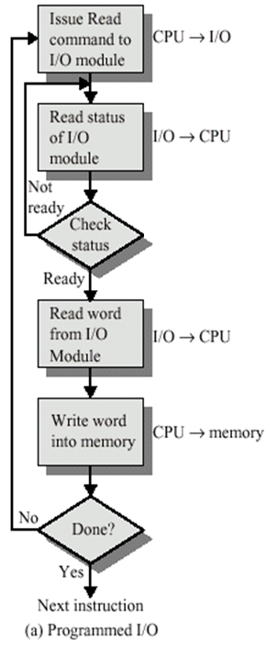
Programmed IO

Slide 49
Limitations of Programmed IO
CPU spends a lot of time testing the IO device status.
Programmed IO transmits data through the CPU rather than allowing it to be passed directly between the main memory and IO device

Slide 50
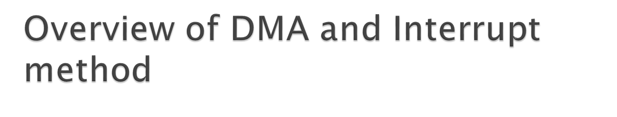
Both the techniques eliminate the need for the CPU to periodically examine the status of the IO devices.
When the device is ready -----→
Interrupt technique----→ Interrupt request signal is given to the CPU.
DMA technique----→DMA request signal is given to the CPU.

Slide 51

Assuming CPU encounters an IO instruction(read data from an input device)
CPU issues a read command to IO module.
While the device is ready, the CPU starts executing another program X.
When interrupt from an IO module occurs, the processor saves the contents of the program counter and the processor registers of the current program on the stack memory.
Processor starts executing an ISR (Interrupt service routine) i.e an IO program which causes the data to be transferred from the IO device to the memory.(Assuming a read operation)

Slide 52
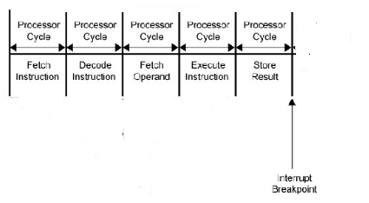
When can the CPU respond to an interrupt request?
CPU is currently executing an instruction of program X and it receives an interrupt request signal from an IO module.
CPU can respond to an interrupt request only at the end of an instruction cycle.
Instruction Cycle

Slide 53
The steps required for an IO transfer through interrupt ------→
IO devices gives an interrupt request signal to the CPU when ready.
The CPU obtains the memory address of the required interrupt handler(ISR).
The program counter PC and other CPU status information of the current program are saved on the stack.
The PC is loaded with the address of the interrupt handler(ISR).
Execution proceeds until a return instruction is encountered which transfers control back to the interrupted program.

Slide 54

DMA is an abbreviation of direct memory access.
DMA is a method of data transfer between main memory and peripheral devices.
The hardware unit that controls the DMA transfer is called a DMA controller.
DMA controller transfers the data to and from memory without the participation of the processor

Slide 55
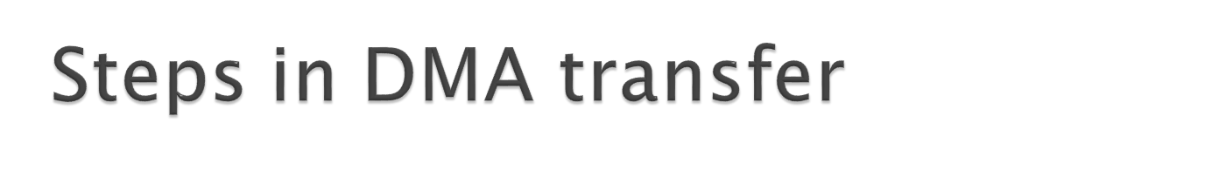
When the IO device is ready it signals the DMAC(DMA controller).
The DMAC sends a Bus request signal to the processor.
Processor completes the current bus cycle and then sends the bus grant signal to the DMAC.
The DMAC performs the transfer between the main memory and the IO device.
Once the DMA operation have been completed, the DMAC releases the bus by asserting the bus release signal to the processor.

